Slide 1




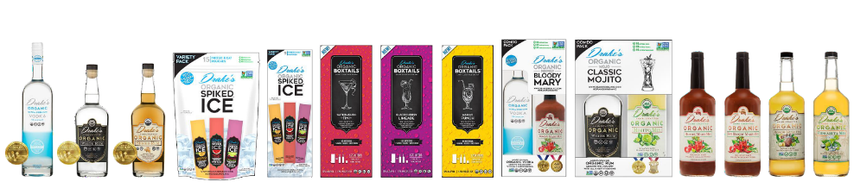

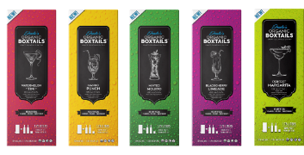

AWARD-WINNING ORGANIC SPIRITS

Slide 2




We source the highest quality, sustainable, organic, Non-GMO Verified cane alcohol.
We lead the industry with 5 certifications.
12 million case annual capacity

Slide 3
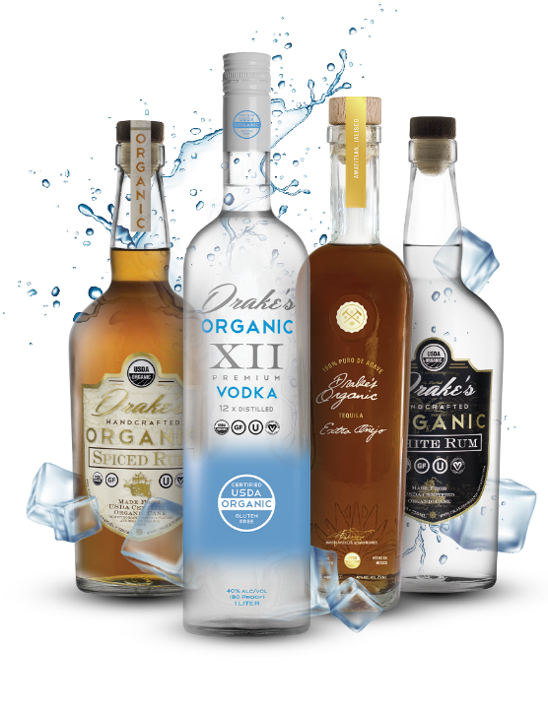
Sustainable Spirits
Drake's Organic Spirits are produced with organic can sugar harvested from fields certified by the USDA rather than from grain alcohol produced from genetically modified corn. This allows Drake's to provide clean, high-quality organic alcohol while reducing soil erosion, and the use of chemicals and pesticides, and lowering carbon emissions.
Better for you, Better for the planet.

Slide 4
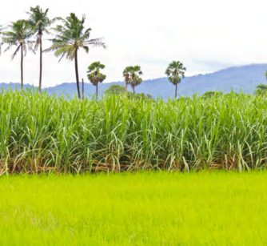
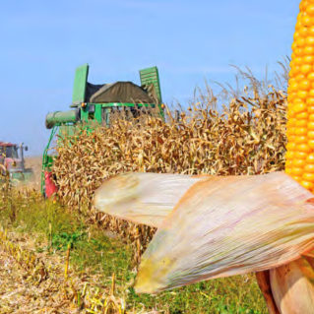
Organic sugar cane alcohol is sustainable and carbon negative compared to corn alcohol.
Sugarcane is a fast-growing grass that can be harvested twice per year for up to four years before the need to replant it. Corn requires annual planting and tilling, and creates a large carbon footprint and causes soil erosion, as well as the release of tons of pesticides and herbicides into the environment.

Slide 5


Energy Balance
7x
GREATER
Sugarcane-based ethanol has an energy balance that is 8 times greater than that of corn-based ethanol.
Energy balance is the difference between the energy expended to convert the crop into ethanol and the amount of energy released from its consumption.
Aurelie Mejeon & Chris Hope. "Modeling the Costs of Energy
Crops: A Case Study of US Corn and Brazilian Sugarcane
SUGARCANE
CORN

Slide 6
Greenhouse Gas
Reductions
40-62%
19-48%
Relative to petroleum gasoline, ethanol from corn can reduce life-cycle Greenhouse Gas emissions by 19-48%. Ethanol from sugarcane can reduce life-cycle Greenhouse Gas emissions by 40-62%
Well-to.Wneels Enerav Use and Greenhouse Gas Emissions by Michael Wang, Argonne National Laboratory
SUGARCANE
CORN

Slide 7
Emission Savings
71%
16-52%
Ethanol produced from sugarcane has a 71% emission saving relative to fossil fuels. Emission savings using corn, wheat or sugar beet are
significantly lower, varying between 16 and 52% depending on the feedstock and the process used.
THE CARBON FOOTPRINT OF SUGAR
By P.W REIN. Louisiana State Universiv
SUGARCANE
CORN

Slide 8
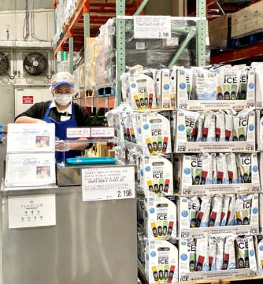
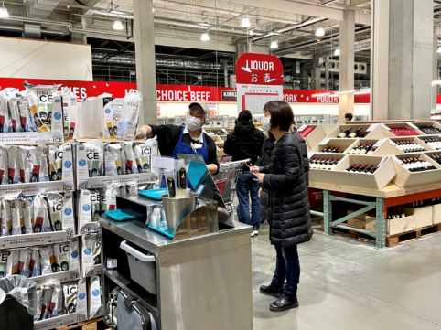
Global Brand
All 5 Certifications
Only spirit line to achieve all 5 certifications including USDA Organic, Non-GMO Verified, Gluten Free, Vegan, Kosher.
Best Value Pricing
Aggressive On Premise vodka and rum pricing at $9 nationally, with 30% margin to Distributor.
Product Line
Organic vodka, organic white rum, organic spiced rum, ready to drink organic Boxtails, and spiked ice. Organic dark rum and organic tequila coming soon.
Costco Japan

Slide 9






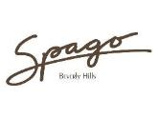









On Premise Partners

Slide 10


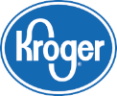













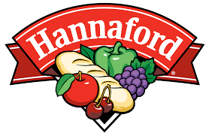
Off Premise Highlights

Slide 11
Product Line

Slide 12
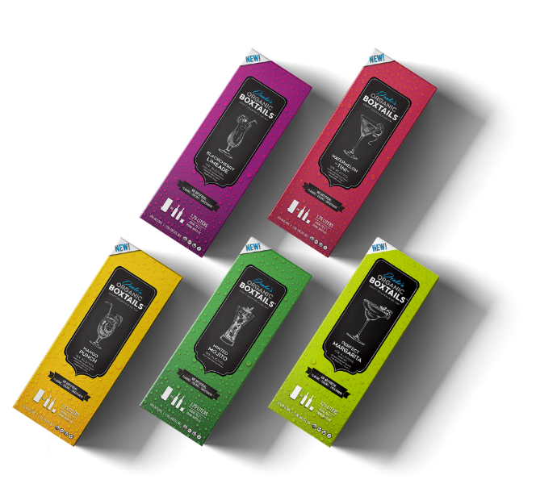



Organic Boxtails
Craft Cocktails in a box
12% ABV
Shelf Stable
1.75L
5 Flavors

Slide 13
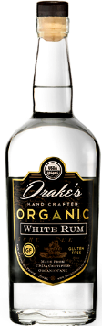

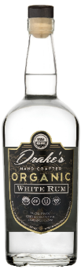
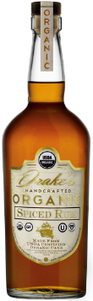

Organic Vodka
Organic White Rum
Organic Spiced Rum
Ultra Premium Vodka at Pourable Price
Distilled from Non-GMO Cane Sugar
Clean, smooth and soft on the pallet
Hint of sweetness on the finish
40% ALC/VOL
80 Proof
Ultra Premium White Rum to enjoy neat or mixed
Silky, Smooth, Bright Flavors
Aged in American White Oak
40% ALC/VOL
80 Proof
Ultra Premium Spiced Rum
Soft, smooth, lingering finish
Hint of Vanilla
Aged in American White Oak
40% ALC/VOL
80 Proof

Slide 14
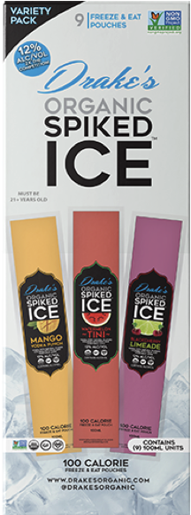
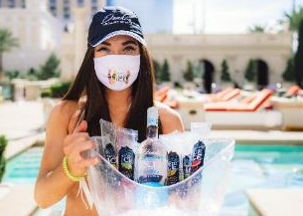
Organic Spiked Ice
Frozen Cocktail
12% ABV
100 Calories
3 Flavors
Award-Winning Organic Vodka mixed with organic flavors and fruit juices in a Freeze & Eat pouch.
Featured at Caesar’s Palace Poolside

Slide 15
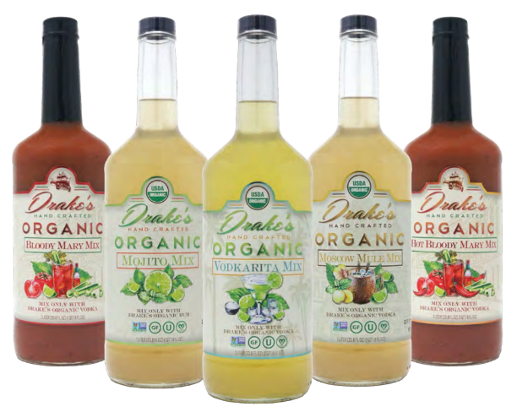
Drake’s Organic Mixers
CERTIFIED
5 Flavors
Made with the highest-quality organic ingredients
No high fructose corn syrup

Slide 16





Certifications
This certification verifies that all raw ingredients and processes we use do not contain any genetically modified organisms.
Ensures all of our ingredients and processes, along with our production facility and bottling plant, follow a stringent set of USDA organic standards.
Any product with this seal must contain less than 20 ppm of gluten. Some eat a gluten free diet for health reasons while others suffer from allergies. This certification guarantees that our product is safe for consumption.
To be OU Kosher certified, we undergo mandatory visits by a rabbi each year to ensure our adherence to strict requirements.
We use coconut fiber filtration to distill our spirits. We are Globally Certified Vegan, and all of our products bear this internationally recognized seal.

Slide 17
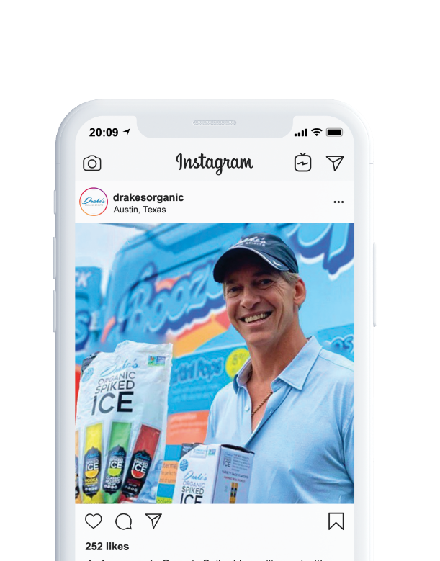



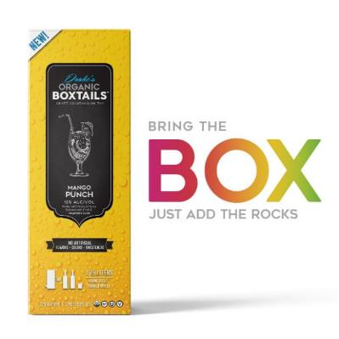
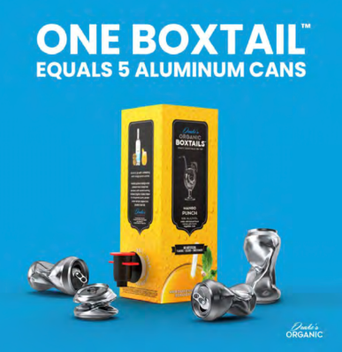
Social Media Presence
168K Followers on Instagram
Daily posts reaching 35K accounts weekly
Drives consumers to retailers
Loyal fan base (i.e. Vegans)
Social Media Pull Through

Slide 18

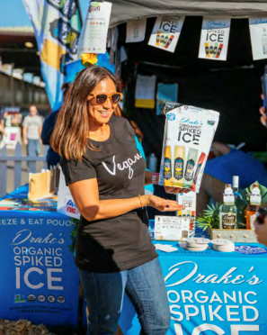
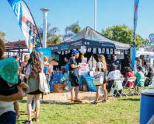
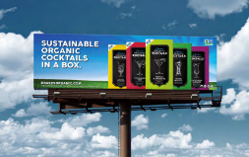
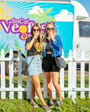
Activation
National In Store Tasting Program
AVP National Tour (Pro Beach Volleyball)
Daytona 500 (Official Sponsor)
Fashion Week (LA, NY, FL – Official Sponsor)
Eat. Drink. Vegan. (Goldenvoice)
Frosty, Heidi & Frank (95.5 KLOS)
Punk Rock Bowling (BYOB Records)

Slide 19
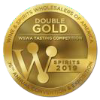
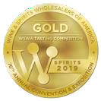
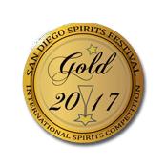
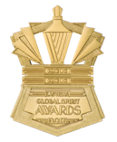
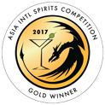
Awards
2019 WSWA Double Gold
2019 WSWA Gold
(Vodka)
(White Rum)
2017 Global Spirit Awards Double Gold
2017 San Diego Spirits Festival Gold
(White Rum)
(Vodka)
2017 Global Spirit Awards Double Gold
(White Rum)

Slide 20

THANK YOU
DRAKESORGANIC.COM
@DRAKESORGANIC

