Slide 1

KnowNOW: We Imagine A World Where Everyone Knows Their Status
Diana Ramirez, MD, Marcelo Venegas, MD
March, 2018

Slide 2
Executive Summary: KnowNOW
We Imagine A World Where Everyone Knows Their Status.
Year Founded | 2017
Company Overview | KnowNOW’s core product promotes timely HIV/STD testing, connects patients to affordable labs, and provides low-cost access to treatment / medications through telehealth platform Other conditions and services include Women Sexual Health, PrEP, and Diabetes Testing
Social Impact | In 2016, STD reached record high level of 2M new cases registered KnowNOW specifically targets vulnerable groups - youth, underserved communities, minorities – where STD rates are highest
Target Customer | KnowNow primarily targets population groups with limited / no health insurance by providing an affordable option to attain STD testing
Financials | Projected revenue: $650K total (2018), $3.9M per state (2019) Projected EBITDA margins: 50%
Funding to Date | $120K
Financial Need | $260K to fund capex and growth
Key Investment Thesis | Large and growing “market” (20M people, $16B spend) with clear impact Sustainable cost advantage translates in pricing: $55 or ~50% below alternatives Lean economics: low fixed cost allow for breakeven even in most conservative cases
Key Investment Risks | Pre-product stage → Product-market fit not tested; traction unclear Additionality risk for areas with existing free testing or low cost alternative are available Financial projections untested; EBITDA margins appear robust
Notes:
Launch: developers – compele integration of backend

Slide 3



Management Team
Ron Kinder, Founder
Diana Ramirez, Lab Ops
Maria Corral, Marketing
Financial services and technology consultant
20 years experience in analytics, risk management, and product life-cycle development
Family physician with over 15 years of experience
Focus on primary care and HIV care
Passionate about preventive medicine
Previously SVP of marketing at Safe Horizon, a leading service provider for victims of crime and abuse
The right team for this solution

Slide 4
The Story
KnowNOW was founded to provide screening of important medical conditions, especially for those who would not otherwise get tested, because everyone should have access to medical care and treatment
  EDUCATE the public about the importance of knowing their HIV, STD and Diabetes status
  CONNECT with testing services for undiagnosed conditions and provide access to providers
  SUPPORT positive patients because everyone deserves proper treatment and care
KnowNOW Meets WIIP
WIIP meets KnowNOW through dedicated outreach in diagnostics sector
Positive initial call with company:
Knowledgeable founder, favorable economic profile, solving unique pain point
Commenced Due Diligence Process
Continue Due Diligence and IC Follow Up
Nov, 2017
Dec, 2017
Jan, 2017
Feb, 2017
Imagine a world where everyone knows their status…
Notes:
Follow ups:
Better understand their actual story and why the company was founded. Would be nice to add a personal touch to the story slide
Elena, can you confirm the timeline bubbles? / General timing of your interactions, would be good to add month at least

Slide 5
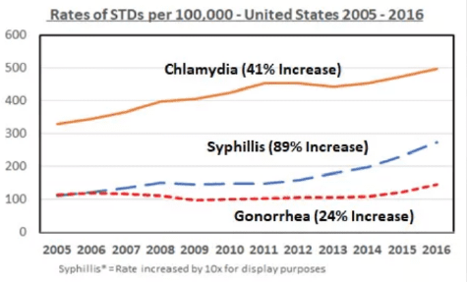
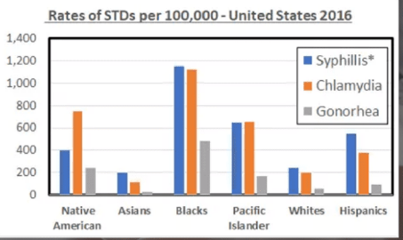
Customer Problem Statement
ACCESS
Becoming increasingly difficult, particularly in underserved communities (eg: incredibly long waitlists at free clinics)
RECORD HIGH STD RATES
EDUCATION GAP
Youth, particularly in underserved communities, lack proper sexual education
LARGER EFFECT ON UNDERSERVED

Slide 6

Case Study: Syphilis
Meet Jeremy
Had minor sore, but did not know what is was
  REMAINED SEXUALLY ACTIVE
  Showed lesion to KnowNOW doctor via videoconference
  Suspected syphilis or HIV
  Sent to lab and TESTED POSITIVE
  Treatment is simple if diagnosed
  SEVERE BRAIN, NEVER, EYE, OR HEART DAMAGE IF UNTREATED
Syphilis is dangerous if not treated
Notes:
Better understand what STD’s they are targeting and their diagnostic process
Are there any stats / figures they look at. How much is this burden costing, can we quantify?

Slide 7
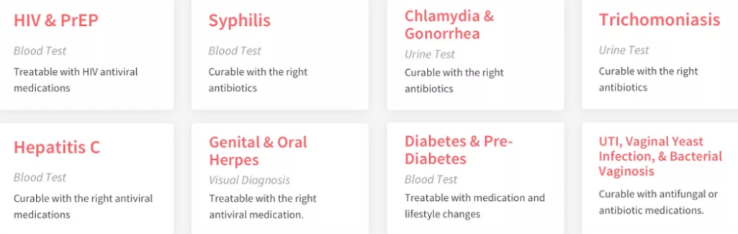

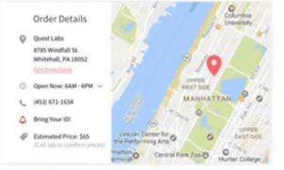

Product Value Chain
1
Patient Selects Desired Test(s)
2
Virtual Review with Doctor ($55 consultation)
3
Evaluates Best Geo-Located Lab Based on Pricing & Availability; Visits Lab for Testing
4
Lab Results in 1 week; Free Consultation with Doctor if Positive Results (ie: receives medication / treatment solutions)

Slide 8
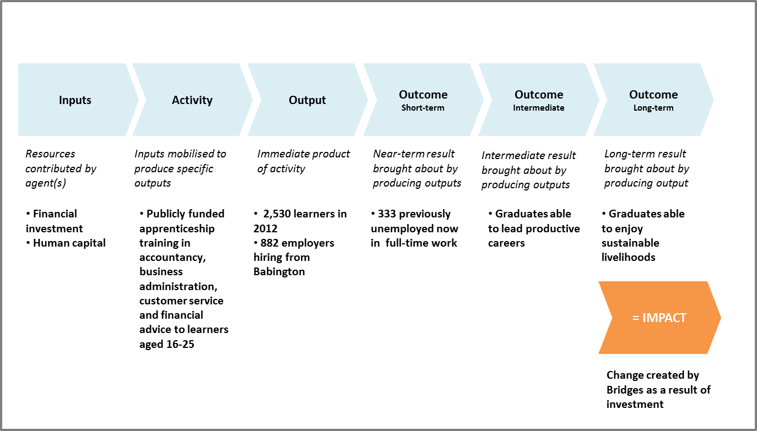
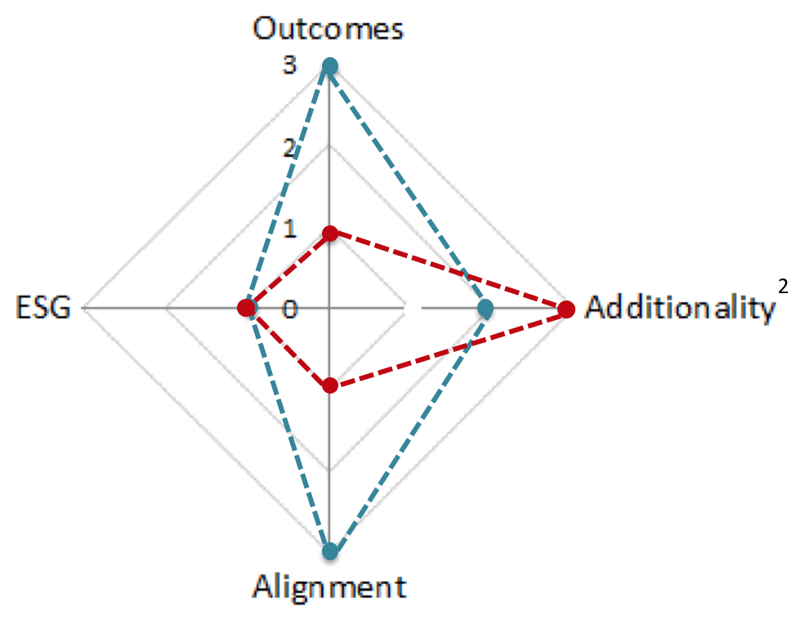
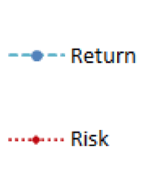
Impact Logic Model & Radar
Financial investment
Human capital
Access to therapist network
Technology (UI application, infrastructure)
Matching patients to labs and providing access to affordable therapist consultations through telemedicine
27,000 users¹ know their status and are able to act on it with prescribed treatment
Short-term: Improved health conditions and confidence
Interim: Decreased contagion rates due to improved awareness on status
Long-term: STD growth trend reverted
8
Note: 1. Based on 2,250 monthly users projection by end of 2018, annualized; 2. Risk of low adoption in areas where free STD testing is available

Slide 9





Market and Competition Analysis
Addressable Market
Competitive Landscape
20M
People with STD’s in the US
$16B
Yearly Cost of STD’s in the US
$6M
Revenue of online STD testing company, STDcheck.com
Affordability
Traditional primary care physicians
Timely consultation / testing

Slide 10
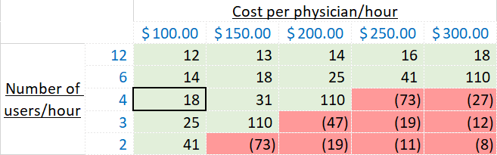
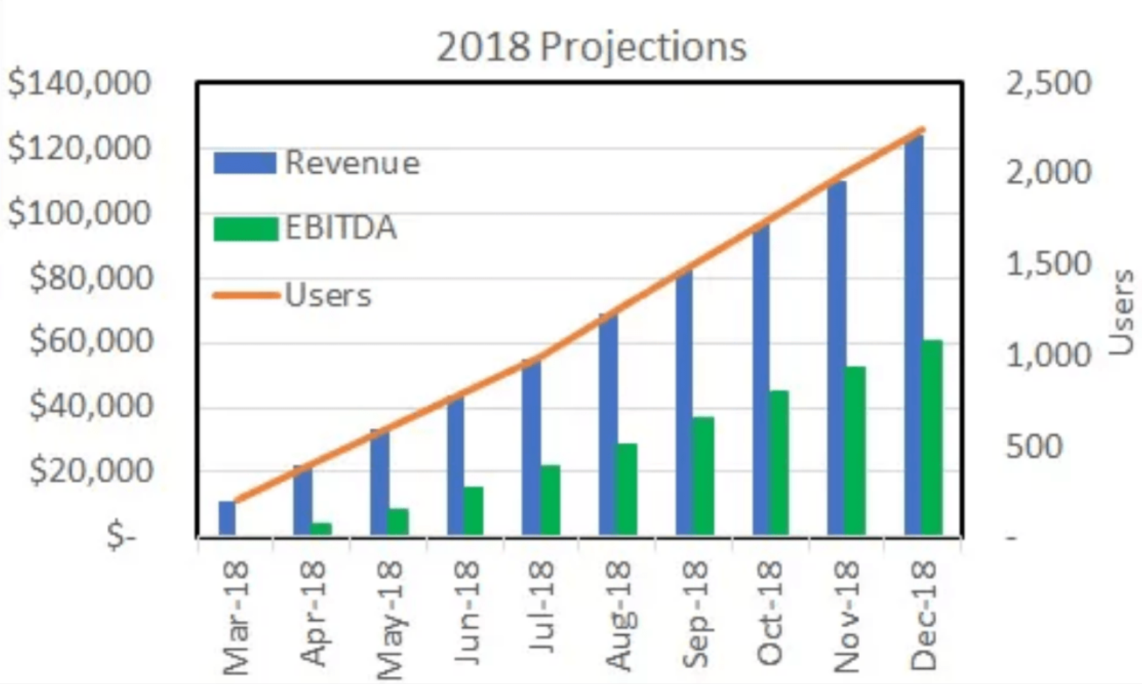
Financials: Management estimates appear reasonable
Unit economics: We estimate
18 users a day per physician for KnowNow to breakeven
Financials: This seems to bid well given management estimates ~20 users/ day for New York only starting May 2018
New York only
Number of users / day to breakeven
(on a per physician basis)
Assumptions (data provided by KnowNow):
~$100 per hour for each physician
~$55 revenue per user
~15 minutes per appointment per user
~$550 in fixed costs per day (nationwide)
~20 users/
day
~40 users/
day
~60 users/
day
To further test:
Given 6 physicians on payroll, what utilization rate are they expecting each? (each physician avail 12 hrs/7 days)

Slide 11
Investment Thesis
Clear and tangible impact
Vulnerable target audience: youth, LGBT, underserved communities
27,000 users knowing their status, ~1000 treatments arranged¹
Improved health conditions and awareness → decreased contagion rates → potential to revert STD growth trend nationwide
Large and growing “market”
20M people with STD in US; $16B spend on treatment
Record high growth: 2M cases registered in 2016 alone
Sustainable cost advantage translated into lower price
Main component of variable cost – therapist pay – lower than face-to-face alternative ($100/hour vs. $160 market average)
Two therapist consultations for affordable $55
Lean economics and scalability of platform
Low fixed cost (licensing and platform maintenance) allow to breakeven at 300 users/month
Platform, once in place, allows for expansion of service portfolio (e.g. weight control, addiction cessation solutions)
Notes:
Scalability for follow-on products on same infrastructure
Marketing – vested 180
Saturating even 1 state would be viable
Scale up: how to market directly to target audience to gain traction
NY, NJ, Maryland, Indiana, Florida

Slide 12
Key Risks
Risk
Description
Next Steps / Mitigants
Customer Adoption of Product Remains Somewhat Unproven
Rollout remains in early stages
Excessive marketing spent
What is steady state adoption / growth rate?
Customer demand appears favorable
To track projections with management to ensure on pace
Technical Risks
Complex integration of multiple partner platforms (Athena for EHR; eVisit for Telehealth)
Launch postponed for 1.5 months due to backend development issues
Tech audit call to be scheduled, engaging a skilled professional to evaluate the degree of challenge
Limited Barrier vs. Well Capitalized Telehealth Providers
Despite being a first-mover in the STD telehealth space, other providers may be able to attract specialized doctors and perform a similar function
Differentiated platform
To conduct market checks to assess positioning and competitive threat

Slide 13
Additional Due Diligence Questions
What Will Pace of User Adoption Be?
To continue dialogue with management about initial rollout in NY / NJ
How quickly can this be integrated into systems, how quickly will patient behavior change?
Will also request initial customer feedback as soon as available
How Will the Company Maintain its Competitive Advantage?
To have more formal call with management focused on competitive dynamics vs. other telehealth providers
Validate Low Cost Offering vs. Other Options
To conduct diligence calls with patients and competitors to validate KnowNOW’s claim of being a low cost provider
Supply of STD focused Telemedicine Docs
To further research availability of the type of doctors KnowNOW needs and propensity to work for this type of solution

