Slide 1
HOW DOES ONE ENSURE THAT A PETROCHEMICALS WAVE HAPPENS IN ALBERTA TOO?!
TO MAKE IT HAPPEN, YOU NEED A RECIPE OF SOLID ROADMAP, STRONG WILL, UNWAVERING PERSEVERANCE, FINESSED BY COORDINATION EXPERTISE!

Slide 2
CURRENT CANADIAN OIL AND GAS OUTLOOK: NOT BRIGHT
Canadian oilpatch may defer $19 billion in capex spending if low prices persist
Canadian pipeline projects for carrying bitumen to tidewater facing uncertainties
Canadian Association of Petroleum Producers says regulations will cost industry billions, demands overhaul
Canadian LNG projects barely moving whereas USA striding ahead even after starting later
90% of petrochemical players believe a second wave of investment is imminent (in the US)

Slide 3
US PETROCHEMICALS WAVE - CURRENT
Five more are under construction and expected to begin operations before the end of 2019.
As part of the first wave of investment in petrochemicals in the recent years, four crackers totaling more than 5 million tonne/year of ethylene capacity are supposed to start operations this year along the U.S. Gulf Coast.
Most of the new plants under construction are cracker-plus projects, and the plus usually includes a polyethylene plant.

Slide 4
US PETROCHEM WAVE (NEXT) & LNG SCENE
Also, around 5 Bcf/day of additional liquefied natural gas (LNG) export capacity is expected to be completed by 2020
Already major players are working on their plans for more crackers and petrochemicals products – FIDs expected this year.

Slide 5
ALBERTA ADVANTAGE – WAITING TO BE SEIZED!
Increasing NGLs availability, low feedstock prices, present an opportunity for investment in Alberta across the value chain.
Industry players are looking for ways to monetize NGLs via the expansion of existing industries (such as petrochemicals).
Global energy pricing dynamics have resulted in sustained low feedstock prices for petrochemical producers in Canada.
Ethane production from Alberta is projected to remain relatively stable over next several years.
Provincial government is trying to boost petrochemicals industry. It has connected with the industry and other stakeholders.

Slide 6
FOR WHICH A SOLID ROADMAP WITH TIMELINES IS REQUIRED
DISCUSSION AMONG INDUSTRY PLAYERS, INVESTORS, EXPERTS, PROVINCIAL GOVT., INFRASTRUCTURE PROVIDERS, SUPPORT SERVICE PROVIDERS, OTHER STAKEHOLDERS
ARRANGE
IDENTIFY
OPPORTUNITIES, INCENTIVES, STRATEGIES, SYNERGIES, HELP REQUIRED FROM PROVINCE
AS PER ASSIGNED
TIMELINES
ON PROPOSALS, ALLIANCES, PARTNERSHIPS, PROJECTS, INCENTIVES TO BE PROVIDED TO INDUSTRY
AGREE
DEVELOP
ACTIONABLE PLANS FOR IMPLEMENTATION
IMPLEMENT
AGREED PLANS TO ACHIEVE TANGIBLE OUTCOMES (PROJECTS)

Slide 7
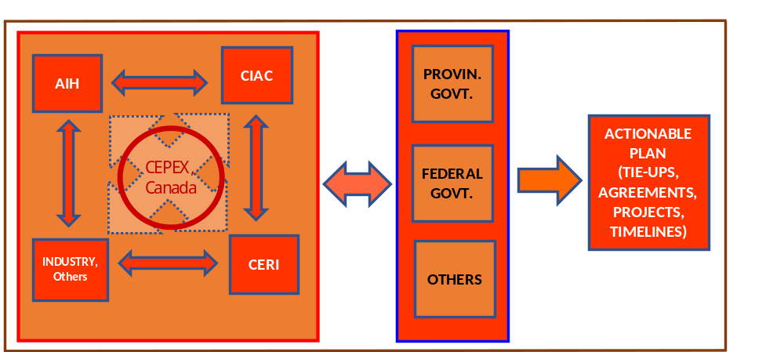
AND, CEPEX COORDINATION EXPERTISE CAN PROVIDE THE REQUIRED FINESSE

