Slide 1


embrace
new opportunities

Slide 2


MARKETPLACE
ADVISORY
COMPANY
BLOG
Arvigor Trading & Co. GmbH

Slide 3

APPROACH
Structured
Systematic
Compact
Lean
Precise
Efficient

Slide 4
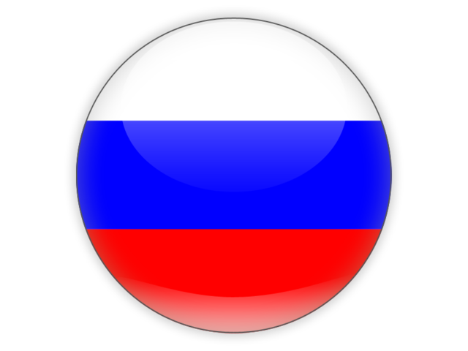





MARKETS
RUSSIA
GERMANY
GREAT BRITAIN
EUROPEAN UNION
ARMENIA
VIETNAM

Slide 5

SECTORS
Information Technology & Telecommunication
Chemicals
& Synthetics
Machinery & Manufacturing
Energy
& Utilities
Textiles
& Apparels
Food
& Beverages
Construction & Construction Materials
Agriculture & Agricultural Technology
Furniture
& Home Decor
Metals & Mining
Transport & Logistics
Wood
& Paper

Slide 6

SERVICES
Trade partner identification and business partner matching. Business intelligence, business negotiation and expert trade advice.
Identification, evaluation and check of suppliers. Sourcing, quotation and monitoring of procurement solutions.
Product marketing, brand positioning and sales strategies. Customer acquisition, market entry preparation and e-commerce solutions.
Market analysis, market research, market risks and trends analysis. Customer segment analysis, competition analysis, product portfolio analysis.
TRADE ADVISORY & TRADE AGENCY
GLOBAL SOURCING & PROCUREMENT
BUSINESS DEVELOPMENT
MARKET DEVELOPMENT
EXPORT MANAGEMENT
MANUFACTURER & SALES REPRESENTATION
EXPORT SALES &
DISTRIBUTION
Export planning and organization, export business plan, regulatory and customs requirements checks. Negotiation and preparation of export documentation.
Sales and distribution via online and offline channels. Arrangement of storage and logistics. Wholesale or retail network options.
Business representation, marketing and project management. Sales event organization, trade mission planning and management.
Arvigor Trading & Co. GmbH

Slide 7

MARKETPLACE
New Customers
Operate 24/7
Save Costs
Multi-channel business
Own store URL
Integrated blog
Ticket support system
Optimized web traffic
Real-time payments
Free SSL encryption
Unlimited bandwidth
Free plan for seller
Accelerate Growth
More Sales
Free Marketing
Customer reviews
In-store SEO tools
International reach
Coupon options
All 12 categories
Fee bonus system
Affiliate marketing
Social media integration
Product feeds

Slide 8


BLOG
Multi-purpose trading company and multi-faceted trade blog
01
Corporate communication and client press
02
Business journalism, exchange and discussion
03
Business community and community chat
04
Public relations management and marketing
05
Client promotion and product advertisements

Slide 9

VALUE
What value can we expect by doing business with you?
We provide tailored and sustainable business solutions to optimize the operational structure and strategic outlook of your business through a complete trade and business promotion platform. Our multi-channel platform centralizes your business activities and creates long-term value for our clients through a compact approach combining advisory services, an e-commerce marketplace and our integrated public relations & marketing system to expand your business in new markets.
Arvigor Trading & Co. GmbH

Slide 10



CONTACT
Glinkastr. 32, 10117 Berlin, Germany
General: info@arvigortrading.com
+49 30 28867307
Media: media@arvigortrading.com
+49 32 226412907
Investor: invest@arvigortrading.com
arvigor.trading
www.arvigortrading.com
Start New Businesses

