Slide 1

Influencer Marketing Platform：Search，Analyze，Contact, Manage, Effect Tracking

Slide 2

Our Story
From 2013, Wondershare started to invest in influencer marketing for the company’s software, and the marketing budget is increasing rapidly every year.
In April 2018, Wondershare employed an influencer resource data sharing pool for internal influencer database resources sharing.
In March 2019, Wonderhsare started to develop an influencer marketing data service platform for external use. Using influencer search and analyze as the entry point, the platform will gradually expand to an all-in-one data services platform including influencers search, analysis, management, and effect tracking.
In April 2019, the InflueNex.com MVP was officially launched, and began its user recruitment and a rapid iterative upgrade...

Slide 3
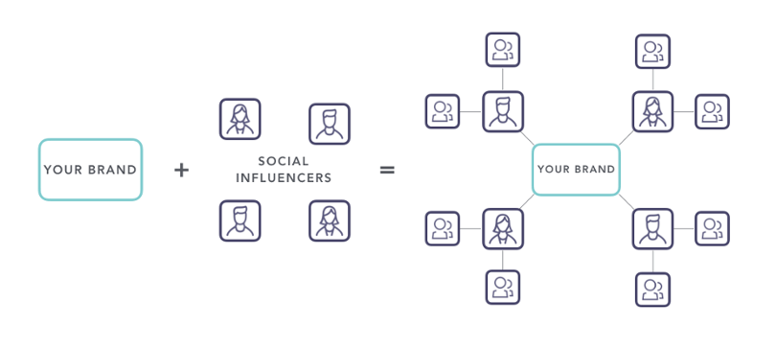
Our Service
Massive Influencer Database
Influencer Filter System
Influencer Price Comparison System
Result Tracking System
Attract influencers to register and increase exposure
Input
Output
Inspiration ,Creativity
SaaS
List of top influencers with Inspire creativity
Influencer Marketing Data Service Platform

Slide 4
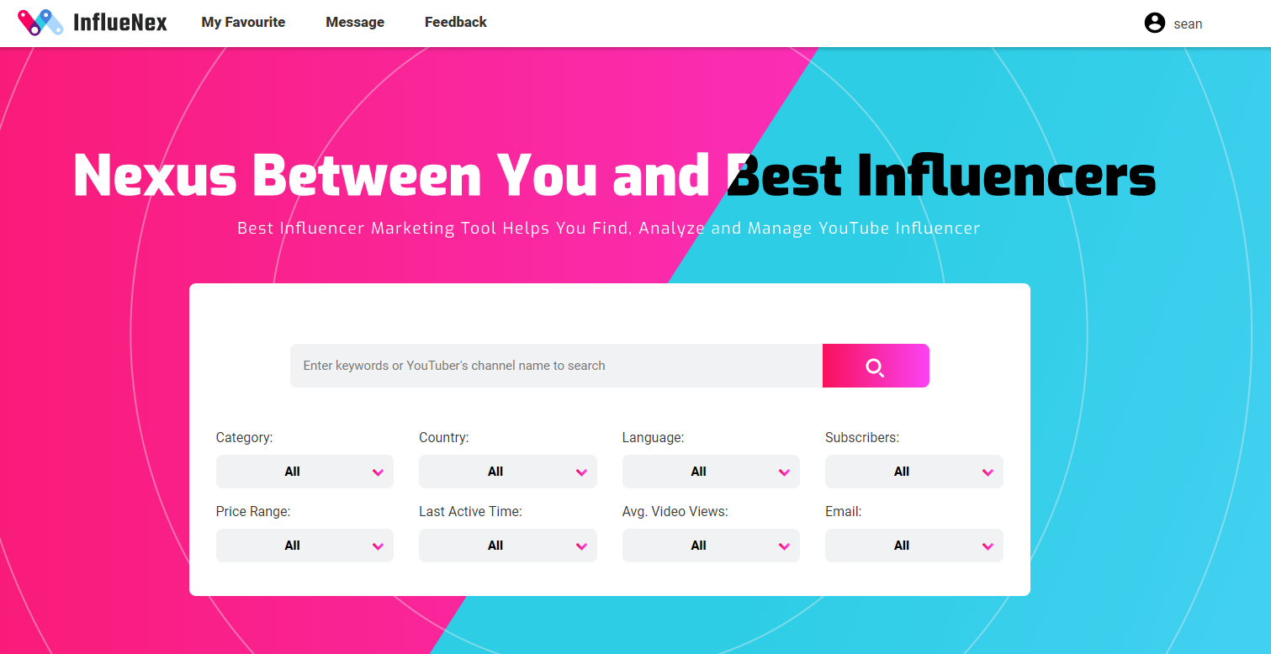
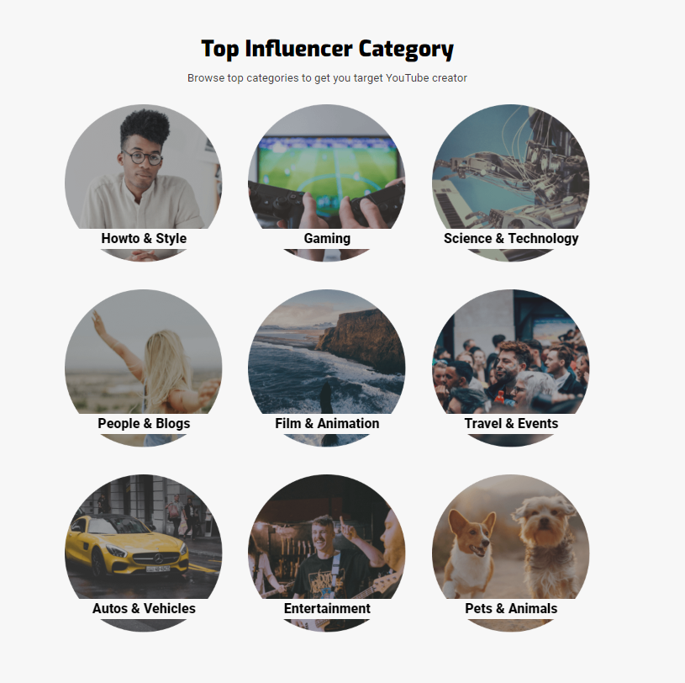
Product Function-Search and Filter
Browse popular influencer categories with
More than 200K YouTube influencer database
enter any keyword and YouTuber's name to search for the relevant content.
rich filter conditions to help advertisers to locate the influencer accurately

Slide 5
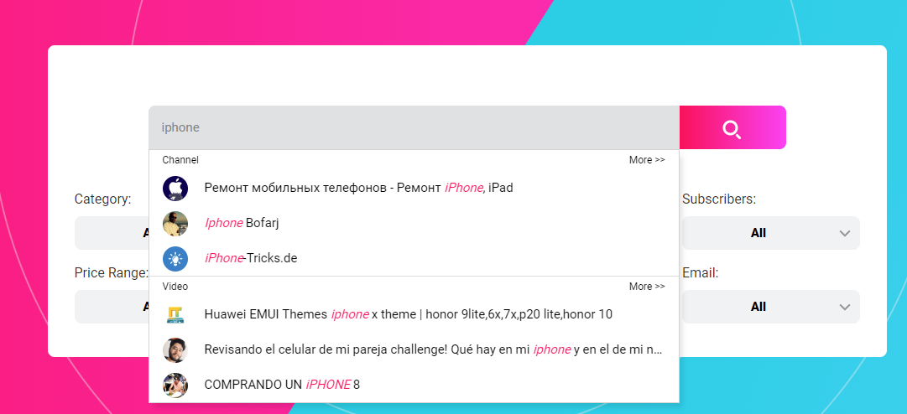
Product Function-More Precise Search
Suggestive search supported.
Recommend related channel and video intelligently.

Slide 6
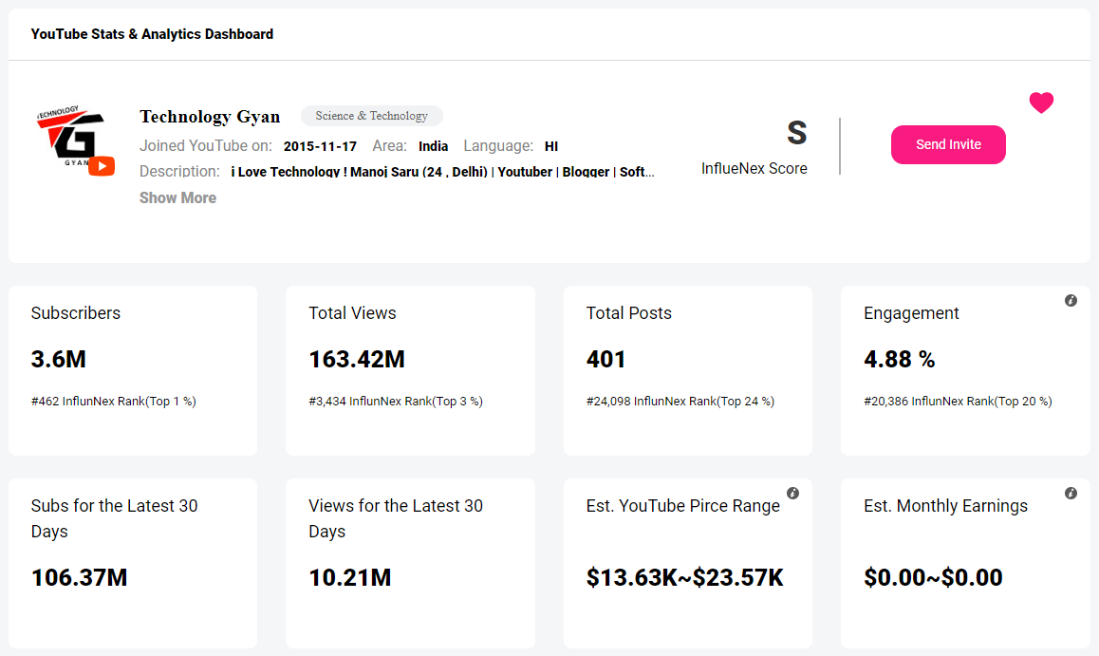
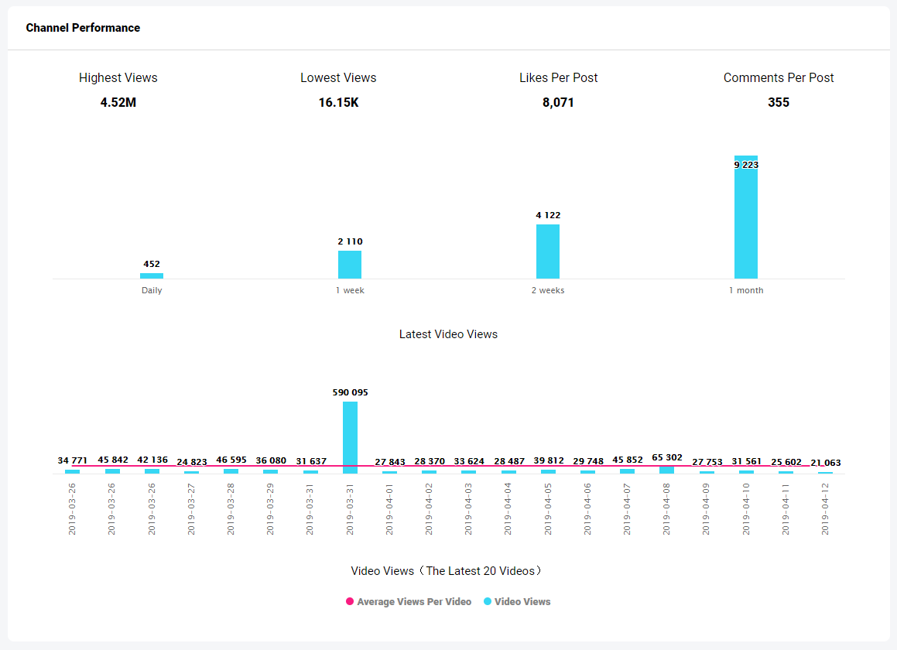
Product Function-Influencer Data Analyze
Multi-dimensional data analysis for objective evaluation of influencers,
helping advertisers to fully understand influencers.
Multi-dimensional comprehensive score system.
Improve the efficiency of finding influencers
Check recent video performance. Understand the influencers’ engagement easily.
View the recent channel performance of influencers, including
video views and average views.

Slide 7
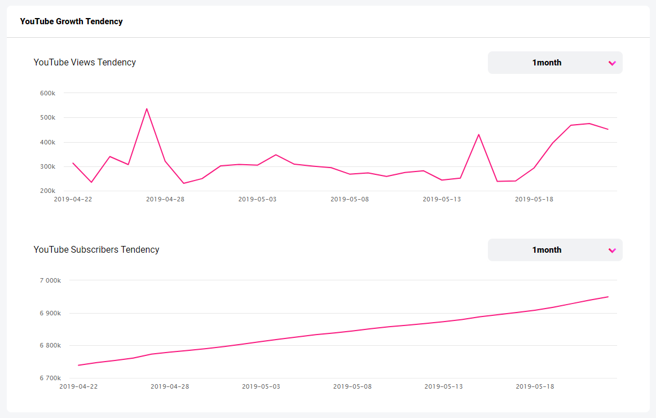
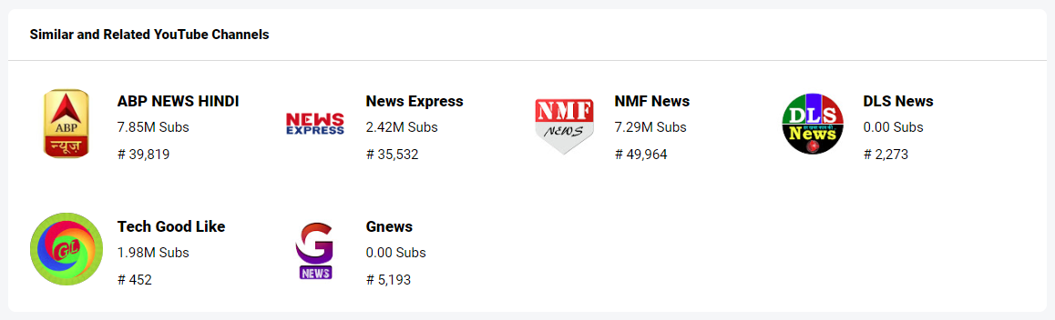
Product Function-Influencer Data Analyze
Understand the influencer’s trend. View the trends of daily views and number of subscribers.
Similar influencer recommendation,
discover similar influencer quickly.

Slide 8
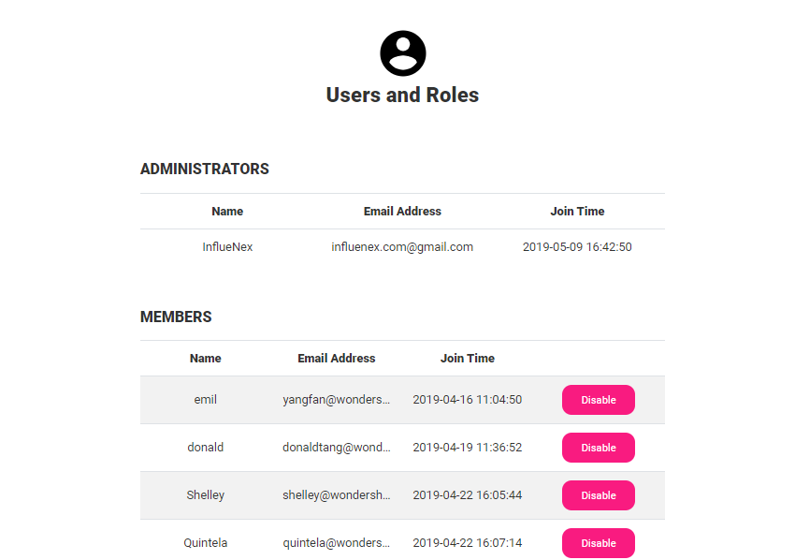
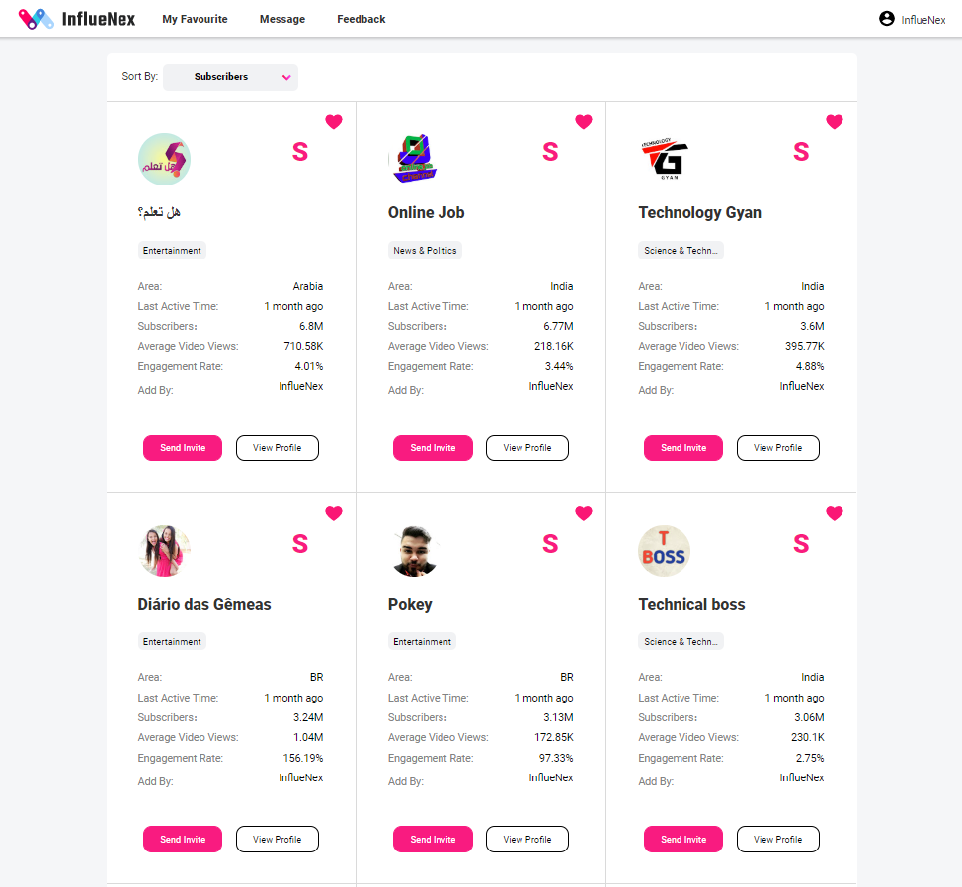
Product Function-Influencer – Bookmark influencers and resource sharing
Bookmark quality influencers for future re-cooperation.
Send direct message to contact influencers with ‘Send Invite’ function.
Multiple members can be added under one account to
share influencer resources among each other.

Slide 9
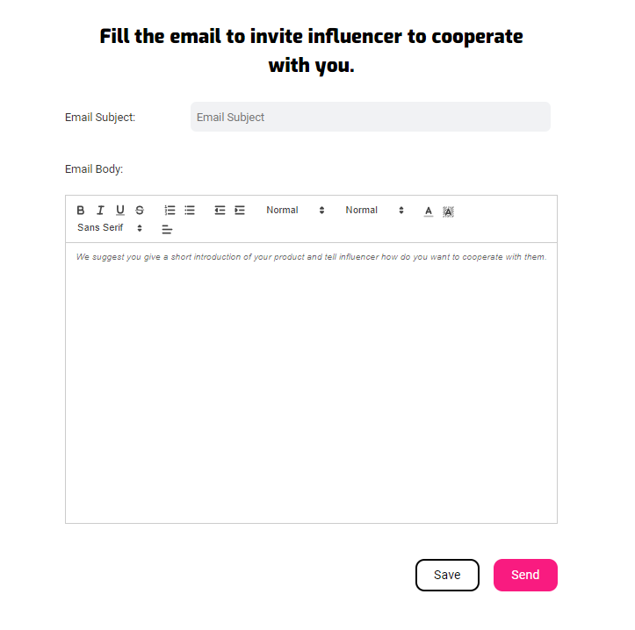
Product Function-Contact influencers via email
Contact influencer with your registered email address.
Replies straightly go to your mailbox.

Slide 10
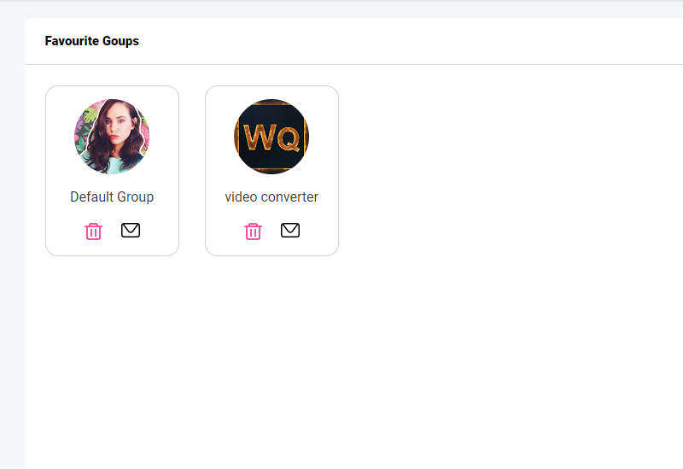
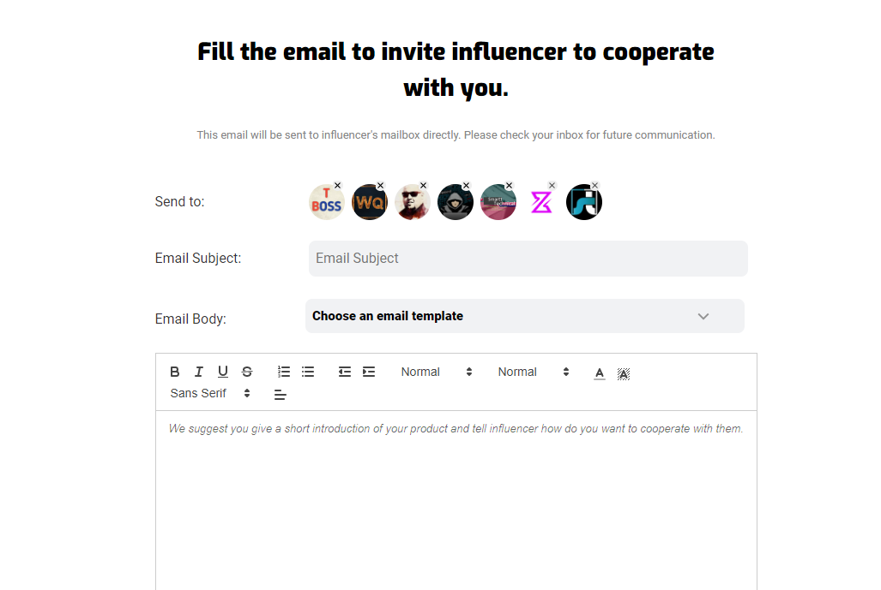
Product Function-manage influencer in higher efficiency
Manage influencers in groups
contact influences with group message sending function
Email template supported

Slide 11
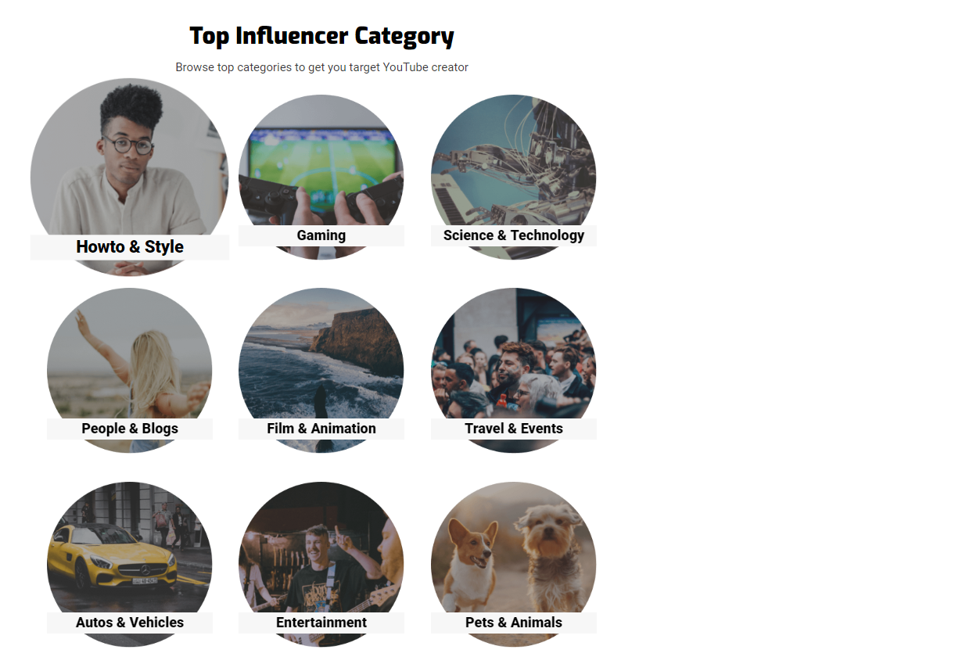
Nexus Between You and Best Influencers
influenex.com

