Slide 1

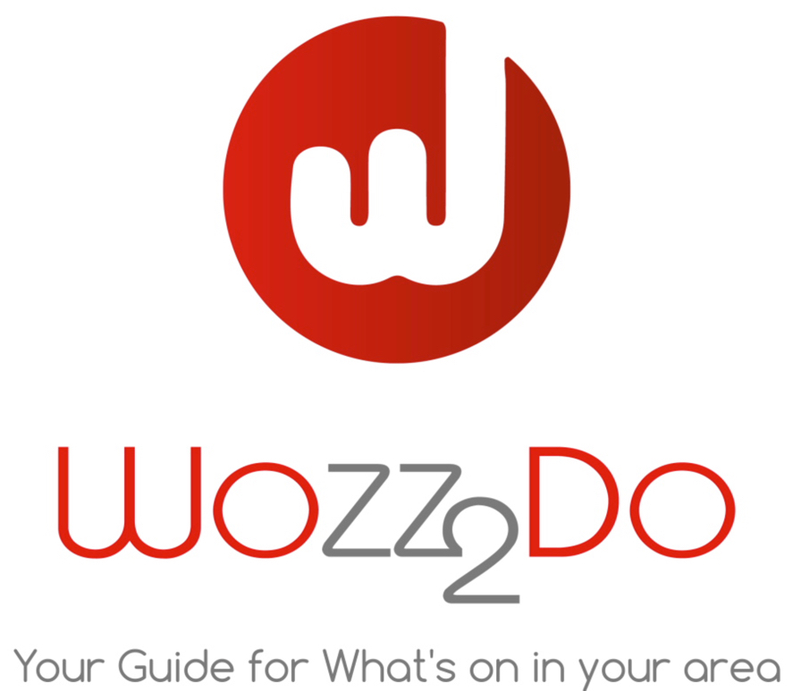
Better exposure for your business?
As A Business, Do You Want:
Your promotions to reach a larger audience?
Keep your customers informed on what you have to offer?
Clients to share your offers with their friends?
Clients to easily access your business details, including a map to your business?
Register and start advertising “live” today!

Slide 2


Slide 3

Like trip advisor and other services, we offer a free business listing, additionally we are the ﬁrst to offer “Real time” advertising direct from your mobile, tablet or computer, adverts easily accessed and not lost in posts!
Advertising Made Easy!
Post an advert within minutes direct to mobile phones and the website.
Free business listing, All your business details available from the app and website (you can edit when you want!), location, opening times, contact details etc!
Connect with a large audience.
Keep your existing customers informed on what you have to offer.
Customers can share your adverts with their friends, making your advert work beKer for you
Simple to use.

Slide 4

A Business Tool To Help Grow Your Customer Network And Improve Business Exposure
Start creating your customer network today!
Your customers download the app and favour your business.
Your now connected! Any posts are sent direct to your customers via their mobile.
Potential customers can see your adverts with a simple search on the app and website.
Keep your existing and potential customers informed on what you have to offer with regular posts.
Customers can share your adverts with their friends, making your advert work better for you.

Slide 5
Stay Connected With Your
Existing Customers
Pass your customers the business card (when making payment) to download the app and favorite your business.
Customers can see what’s on today, this week or this month!
Every time your post an advert the customer receives your advert, direct to their mobile.
Then keep your customers up to date with your latest events and offers!

Slide 6

Wozz2do Easily Grows Your Network
Of New Customers
Your adverts can be accessed by potential clients thru the simple search
facility on the app and website.
Your existing and potential customers can easily share your adverts with their friends using their mobile on;
Generating Better Exposure For Your Business!

Slide 7
wozz2do Networking –
How can this beneﬁt your business?
Believe it or not, you already have a network in place! This is based on customers that know about your establishment.
Imagine
Unfortunately this network is not working for you as efficiently as it could, consequently loosing valuable business!
The ability to keep current customers informed on what you have to offer with “real time “ adverts direct to their mobile!
For example, how do your customers know about your latest promotions, events or offers? How do you keep them informed?
Current customers can introduce you to potential new customers by sharing your advert via social media, text messages etc,
growing your network of customers and giving your business better exposure.
Newspaper? Facebook? Radio?
All of these are good means of advertising (in some cases costly!) but do not allow you to connect directly with your network of existing and potential clients.
wozz2do advertises to the locals and visitors so we connect with more users of the service, once again giving more exposure
to your adverts and more potential business.
wozz2do is an app and website that allows you to connect with your existing clients and future clients and generating more growth for your business.

Slide 8
All Paths Provide Exposure To Your Business!
Marketing
New clients
Wozz2do advertising platform
Your business
Existing clients friends
Existing clients

Slide 9

Wozz2do Keeps On
Growing GROW WITH US!
wozz2do is always growing! We advertise to customers living in the area as well as tourists visiting.
wozz2do will target audiences to download the app and use the website with advertising in airports, radio, newspaper and social media, the public will also share the app with their friends.
This all means your business and your adverts will be seen by a huge audience which is ever growing.
Your adverts can be accessed by potential clients thru the simple search facility on the app and website.
Creating Unlimited exposure for your business!

Slide 10

So Where To Start!
Create your profile (this will also be your free business listing on the app and website).
Notify your clients to download the free app and save your business as a favorite on the app.
So what does the above achieve?
You now have a tool that allows you to keep your customers informed on any events, offers or promotions your
business has to offer.
As a client favorites your business, they become part of your network, automatically notified of your adverts as they are placed.
Your existing and potential clients can share your advert with their friends and their friends with their friends, and so on creating and endless network for your business, which is ever evolving. Every time you post, all the people in your network will be notified!
With a large audience using the service your adverts can easily be accessed by existing and potential clients.
“Real time” adverts, as you post , this is instantly available for your existing, and potential clients to view from the app or website.
Your customers in your network can also save your advert, how does this benefit you?
If you offer a discount, the client can show the advert when they come to your establishment to redeem the offer! Customers love a deal!

Slide 11
Create A Business Proﬁle
In Minutes!
Your business proﬁle can be accessed by the customer, allowingl them to see your location, description, contact details etc.
Upload a banner photo (preferably landscape picture).
Save your proﬁle
02
04
01
03
05
Upload your logo.
Add your business details, location, description opening times, contact details.
that’s it, you can now start posting adverts!

Slide 12


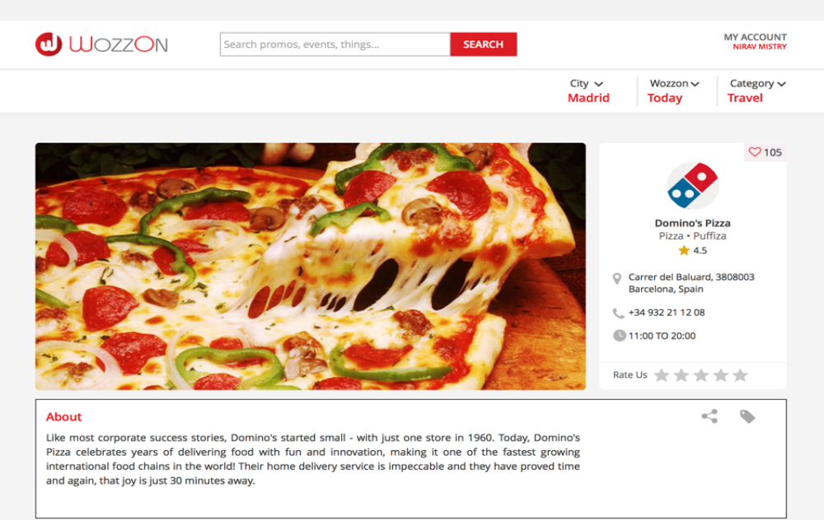
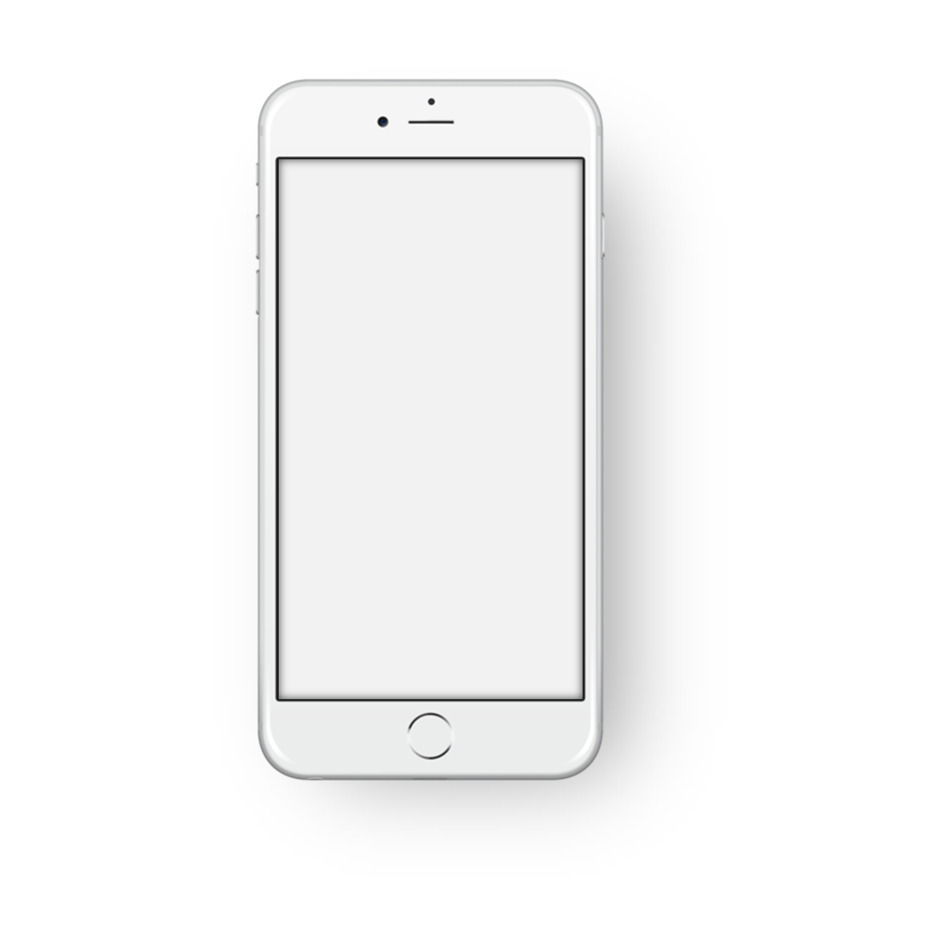
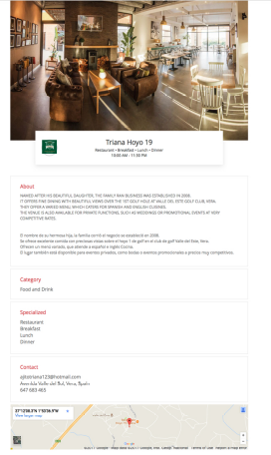
Appealing Informative Proﬁle!
Example of the website
Example of the App

Slide 13

Create An Advert
In Minutes!
01
Upload images for the promotion (preferably landscape picture).
02
Enter the category of the promotion (for example “live entertainment’).
03
Add a description.
Now you have created your business proﬁle
you can start advertising your promotions
04
Date of the promotion
05
post it!

Slide 14

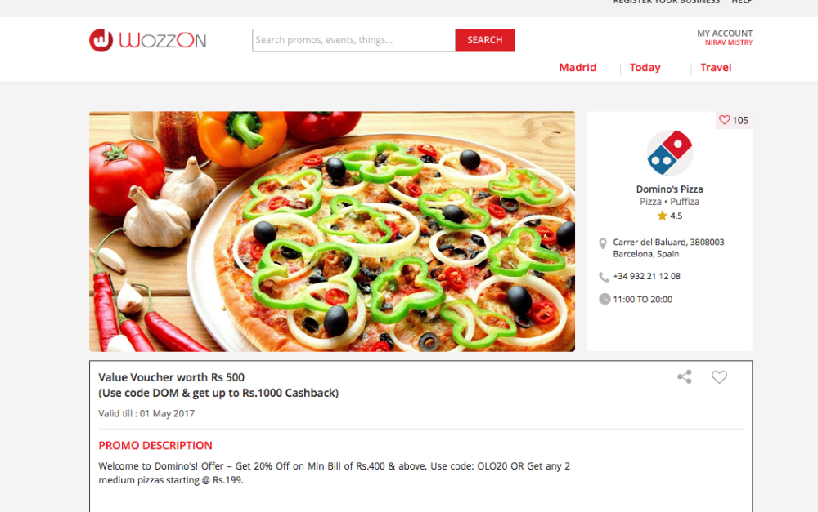
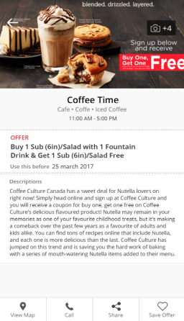
Appealing Adverts
Example of the website
Example of the App

Slide 15
Start placing your adverts today!

